Slide 1

March 2016, by Stéphane Molina

Slide 2
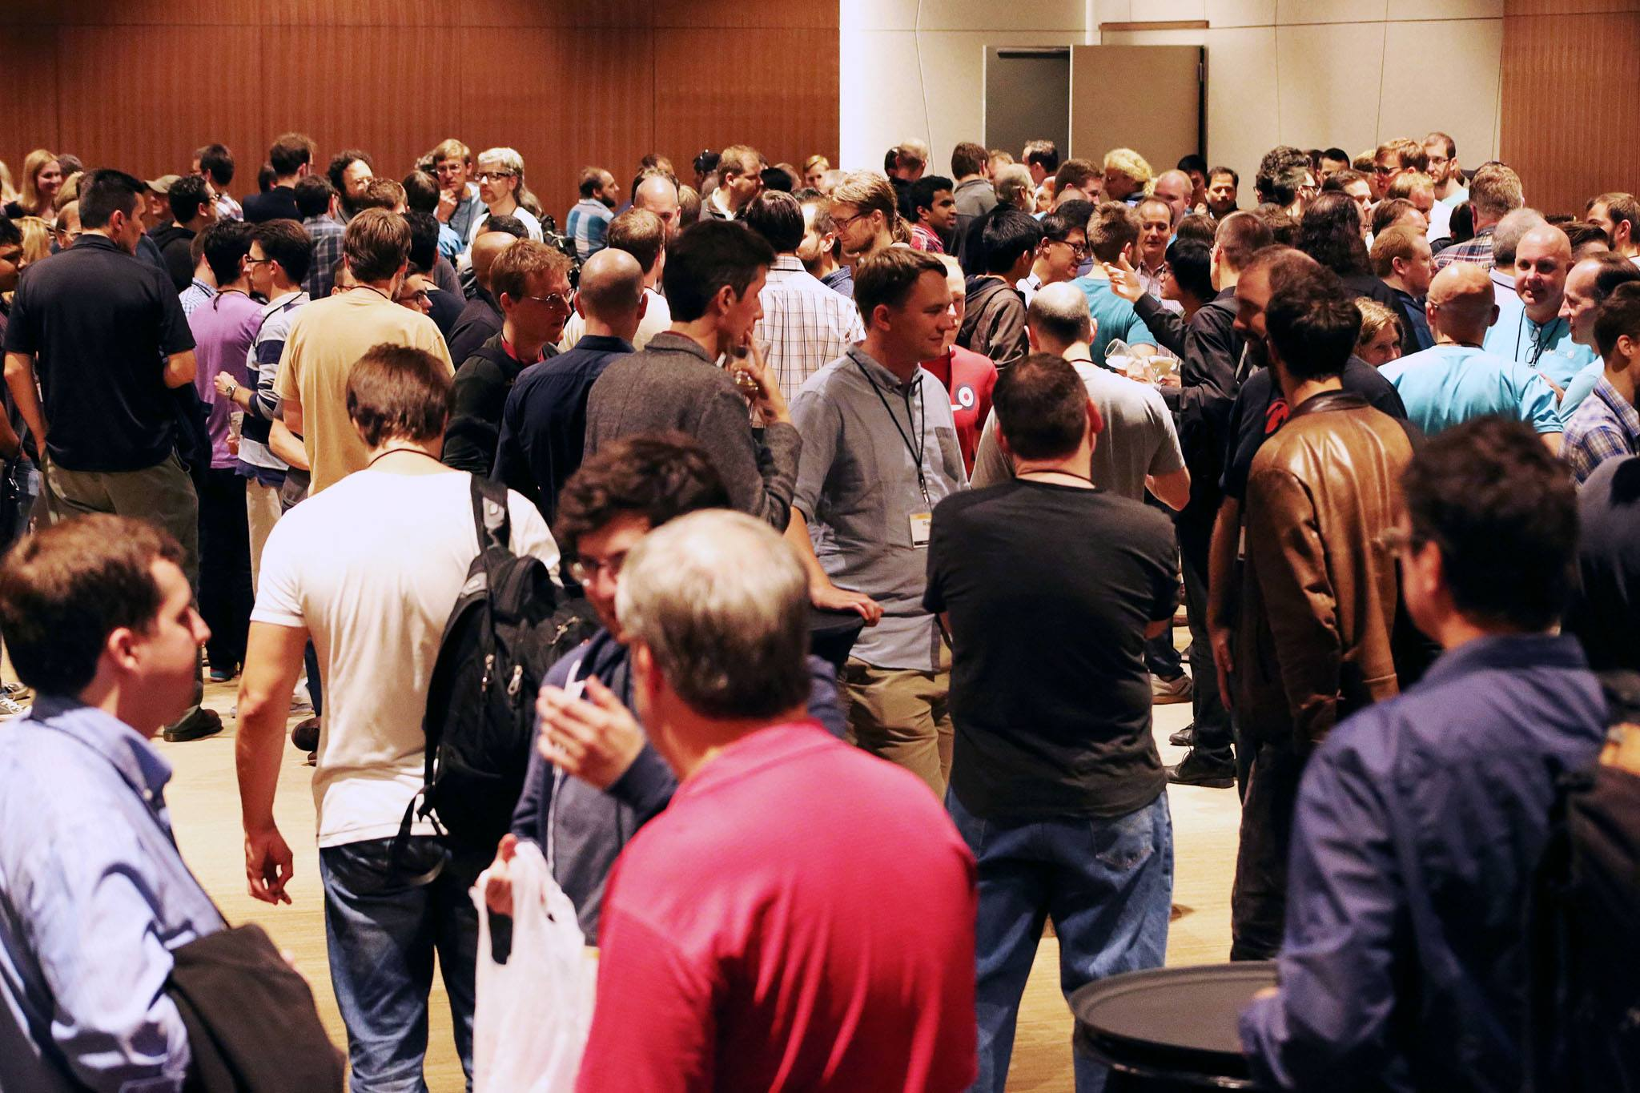
What is CppCon?

Slide 3


Main conferences in 2013
Ex BoostCon
Every March since 2007
Aspen, Colorado
Middle of nowhere!
5 days event
Boost oriented presentations
150+ attendees
Every December since 2012
Berlin, Germany
2 days event
450+ attendees

Slide 4

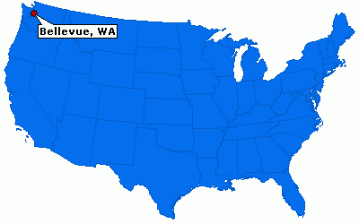
About CppCon
Created by isocpp.org in 2014
Bellevue, Washington
Every September
700+ attendees
50+ speakers

Slide 5

Conferences motivations
Meeting other C++ people
Sharing
Ideas
Frameworks
Knowledge
Educating people

Slide 6
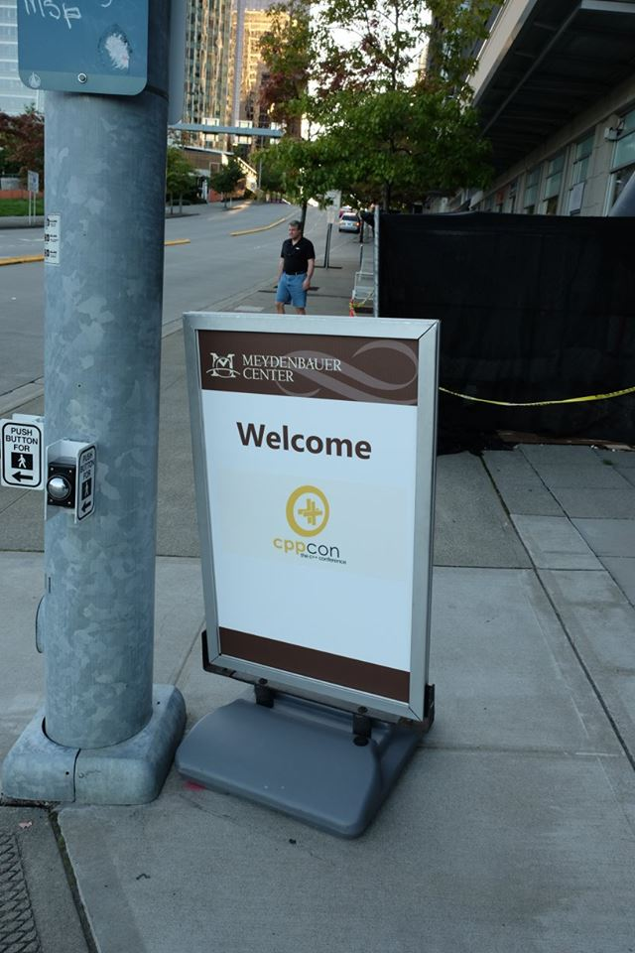
Program
Pre-conference classes (2 days)
Concurrent Thinking in C++
Using C++ for Low-Latency Systems
Modernizing your C++
5 days event
Keynote
Lectures
Lightning talks
Evenings events

Slide 7
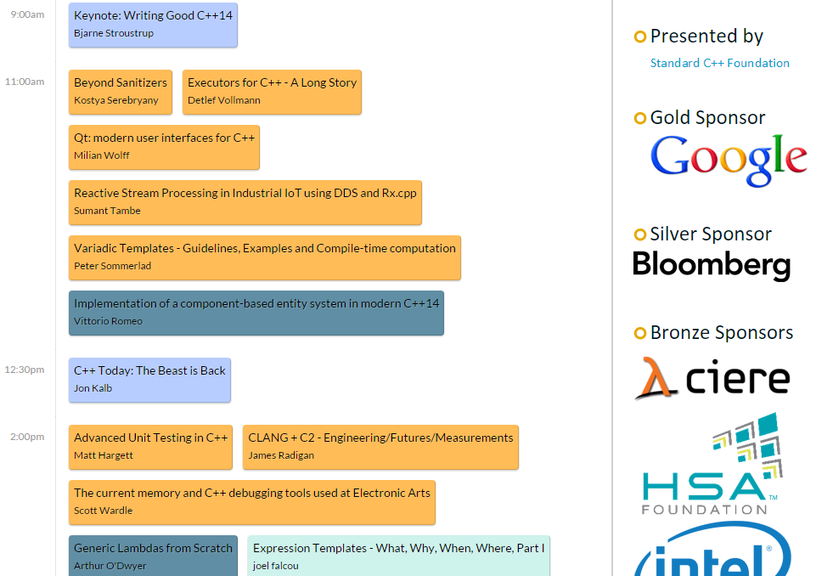

Slide 8
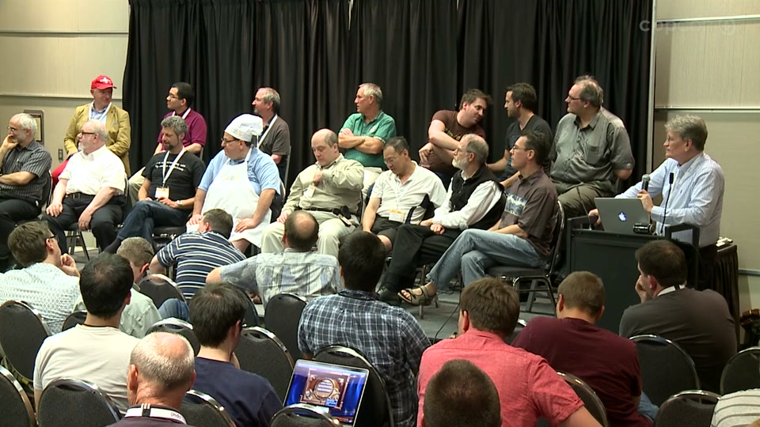
Who attend CppCon?
Short list of people involved into CppCon
Bjarne Stroustrup
Herb Sutter
Chandler Carruth
Andrei Alexandrescu
Many more… (isocpp.org and C++ committee)

Slide 9
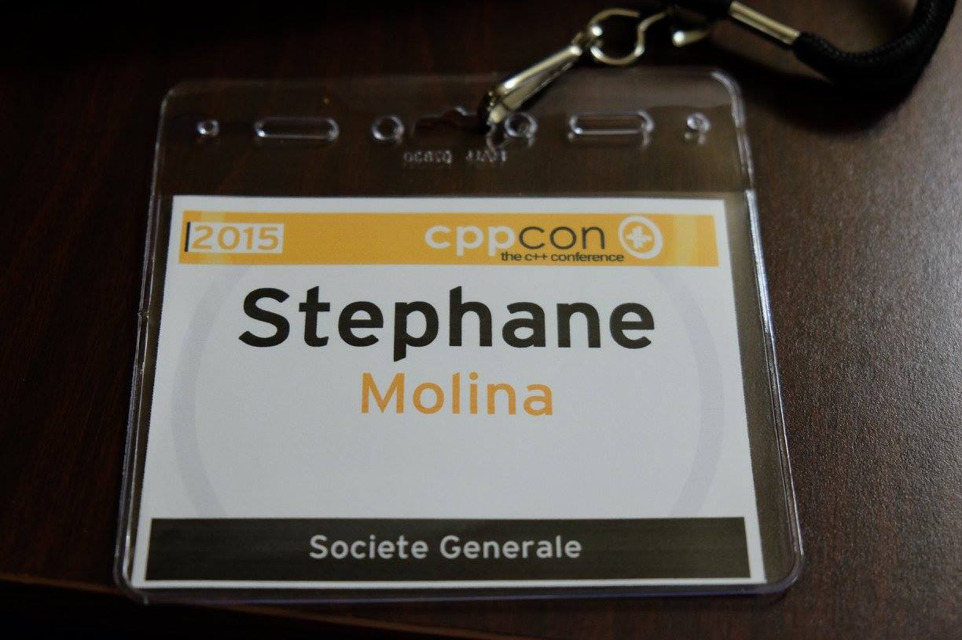
Let’s start

Slide 10
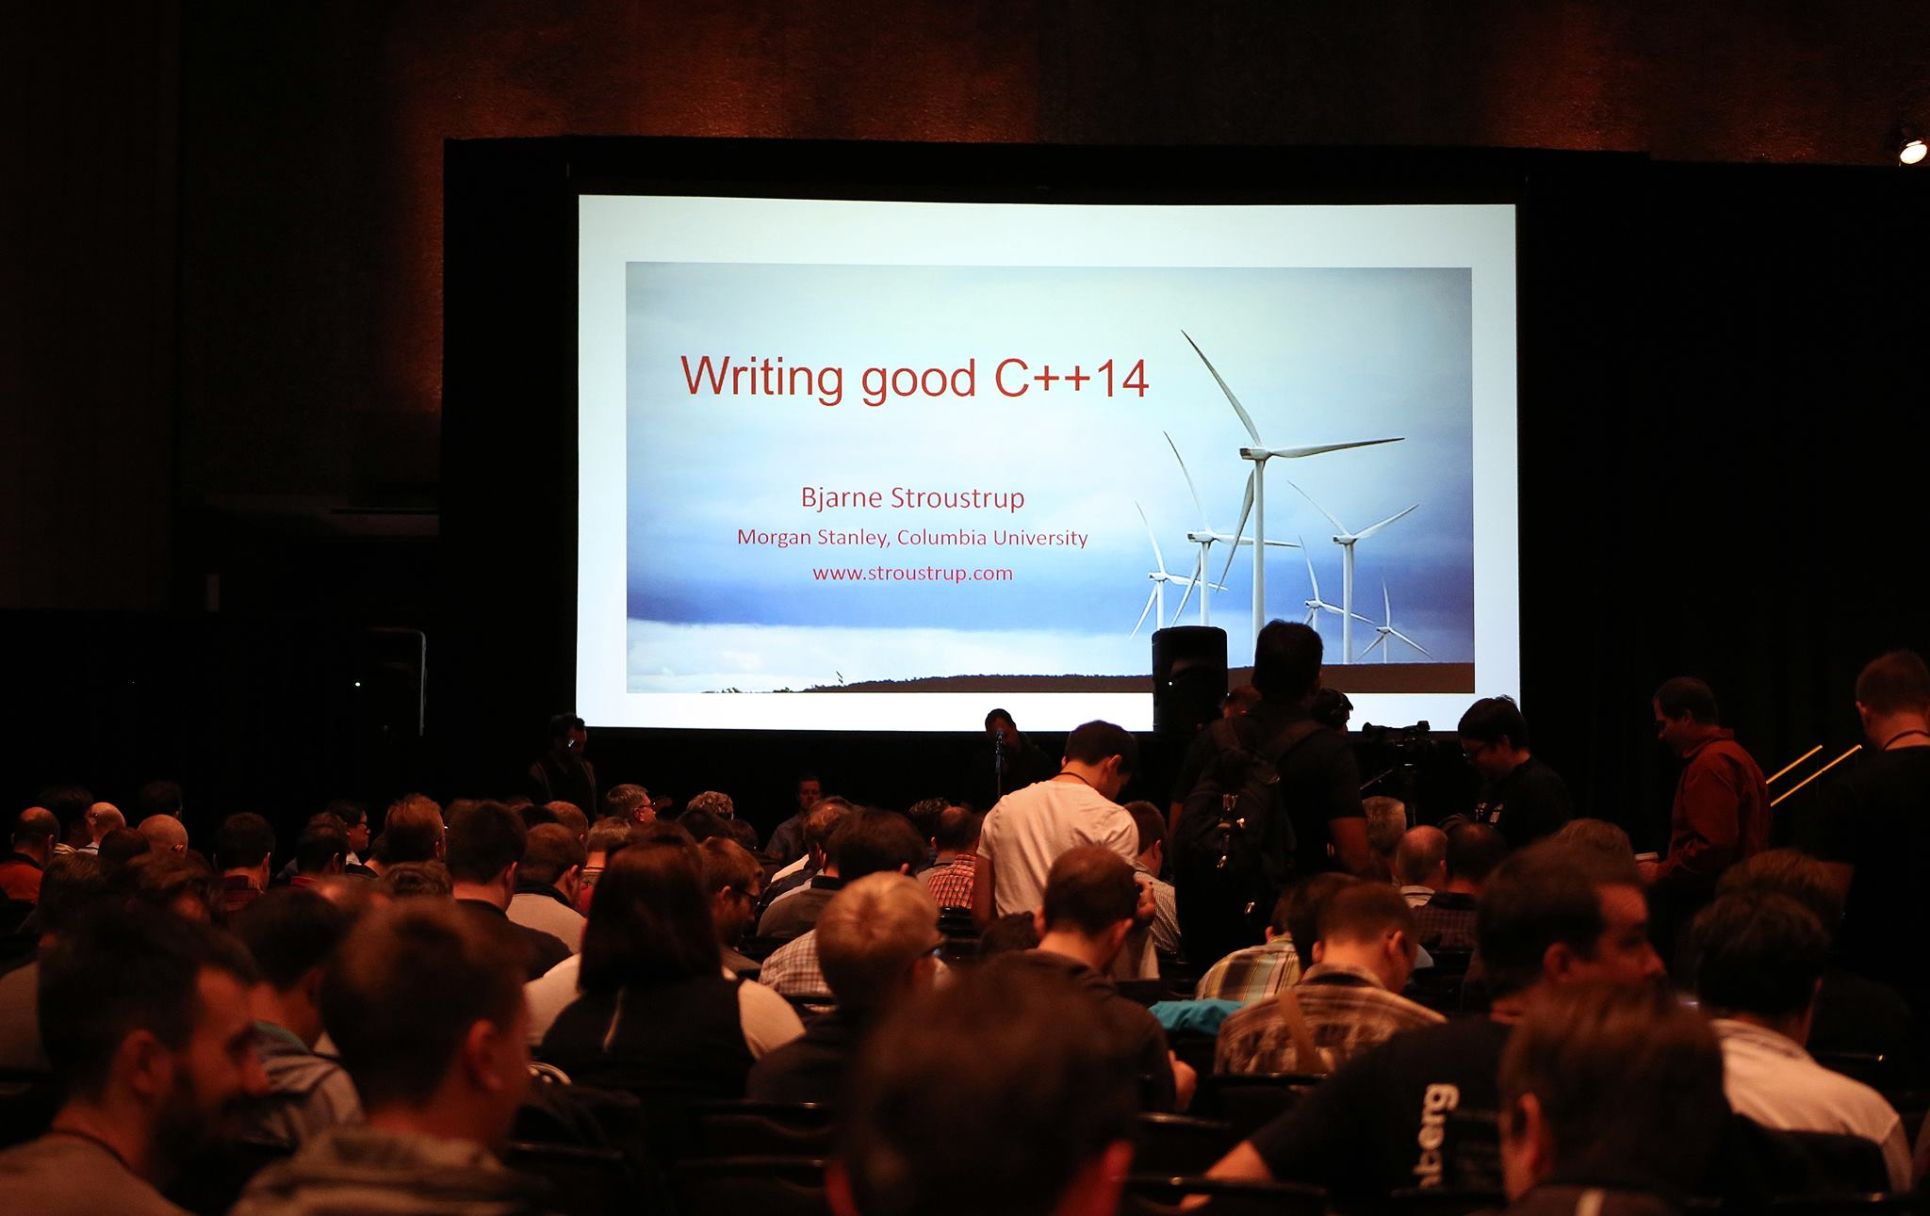
Let’s start

Slide 11
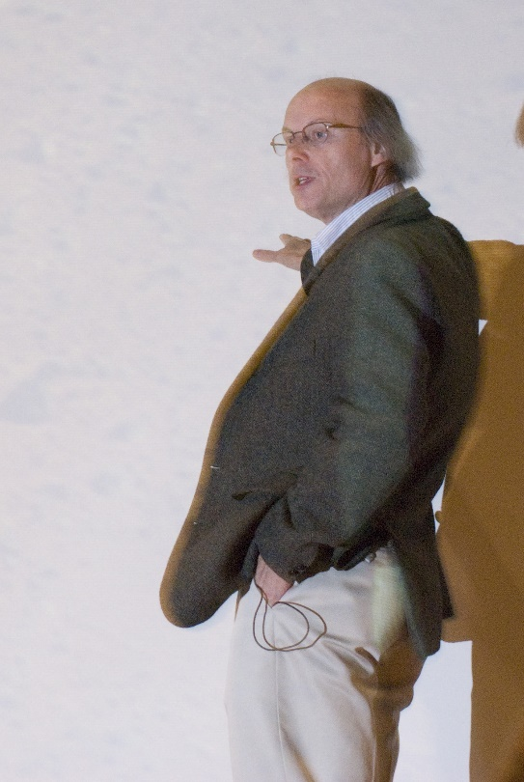
The problem and the opportunity
“What is good modern C++”
Many people want to write “Modern C++”
Resources that explain how to write good code are uncommon
We have a great modern language
C++11 (good) / 14 (better) / 17 (even better! (we hope))
Technical specifications
Easier to read / write / maintain
Runs faster
Can express more than older C++ (with less code)

Slide 12
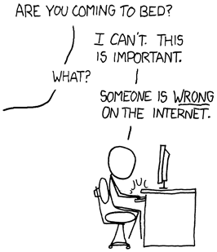

The problem and the opportunity
Many people
Use C++ in archaic or foreign style
Get lost in details
Are obsessed with language-technical details
“Within C++ is a smaller, simpler, safer language struggling to get out”
Code can be simpler
As efficient
As expressive
Without inventing a new language
100% compatibility – compile with current compilers

Slide 13

A smaller, simpler C++
Coding guidelines
Supported by a “Guidelines Support Library” (GSL)
Supported by analysis tools
Don’t sacrifice
Generality
Performance
Simplicity
Portability across platforms

Slide 14
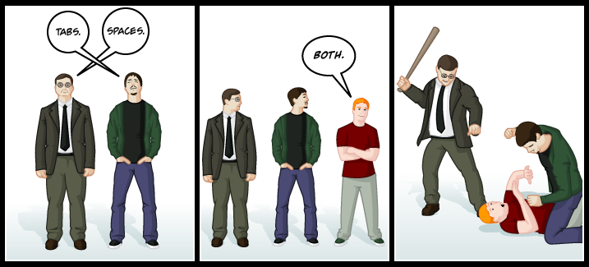
What is not GSL
Rules focus on
“Layout and naming”
Not on programming principle
Rules are full of bad advice
Write C / C with classes / pseudo-Java
Outdated
Not understood by their users
Platform / compiler dependent

Slide 15
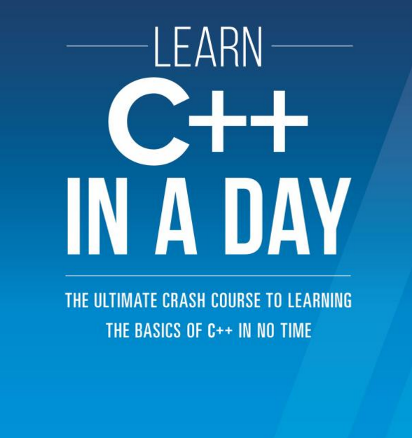
GSL goals
Build good set
Comprehensive
Browsable
Supported by tools (from many sources)
Suitable for gradual adoptions
For modern C++
Prescriptive
Not punitive
Provide guidance
Tell what to do, in what situation, and why

Slide 16
Example (github.com/isocpp/CppCoreGuidelines)
Guidelines are focused on higher-level issues
Interfaces
Resource management
Memory management
Templates
Concurrency
Parallelism
Lock Free
SIMD
…

Slide 17
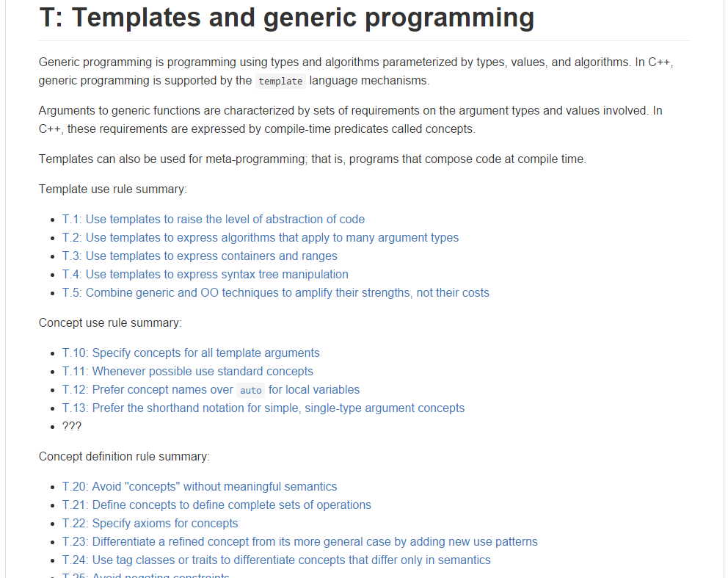
Example (github.com/isocpp/CppCoreGuidelines)

Slide 18
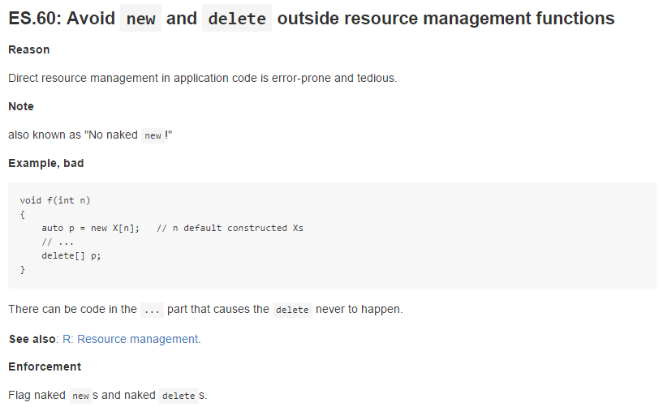
Example (github.com/isocpp/CppCoreGuidelines)

Slide 19
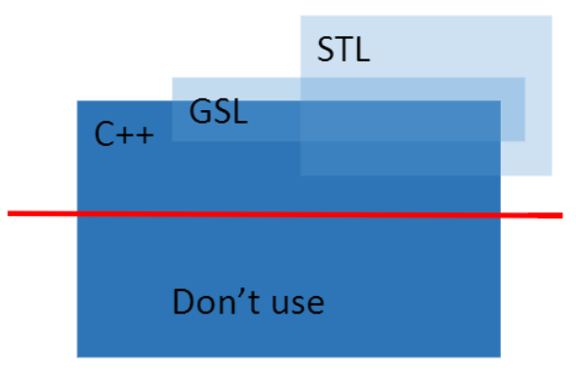
Extend language with a few abstractions
Use the STL
Add a small library (GSL)
No new language features (concepts, networking, …)
Support the set of the core guidelines
Design to be extremely lightweight (zero-overhead)
Some of the features might become part of the Standard

Slide 20
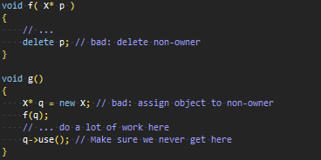
Example of GSL feature : owner
Ensure that no pointer outlives the object it points to
Mark an owning T*: owner<T*>
Initial idea
owner<T*> would hold a T* and an “owner bit”
Costly: bit manipulation

Slide 21
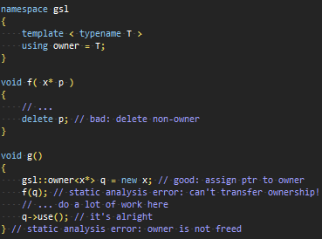
Example of GSL feature : owner
So our GSL owner is
A handle for static analysis
Documentation
Not a type with it’s own operations
Cost free: No run-time cost (time or space)
template <typename T> using owner = T;

Slide 22
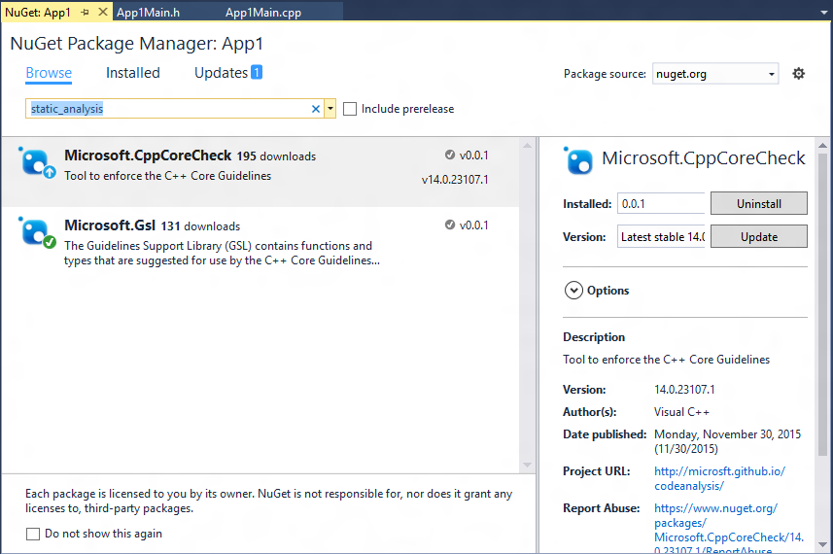
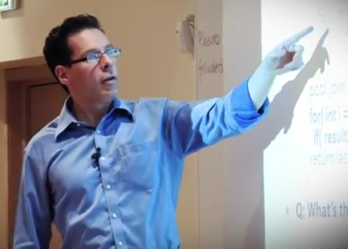

Writing Good C++14… by default

Slide 23
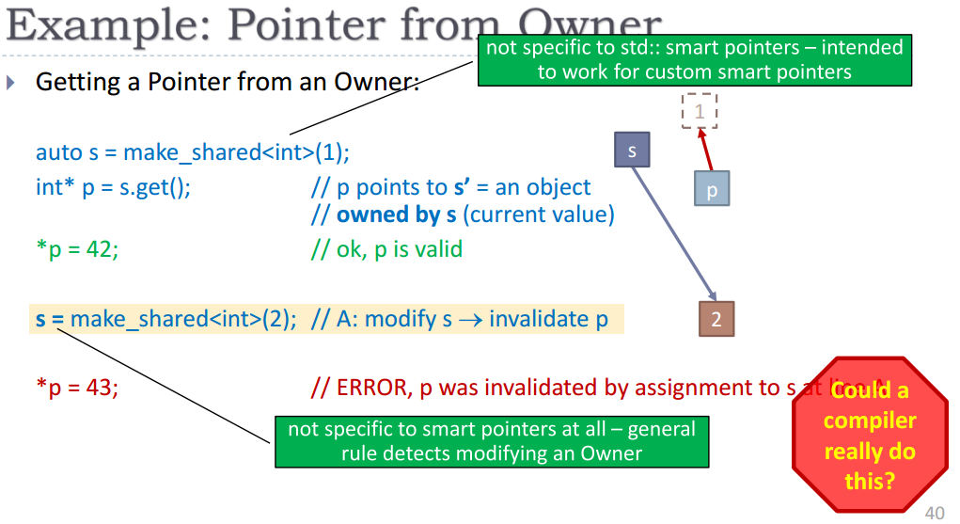

Writing Good C++14… by default

Slide 24
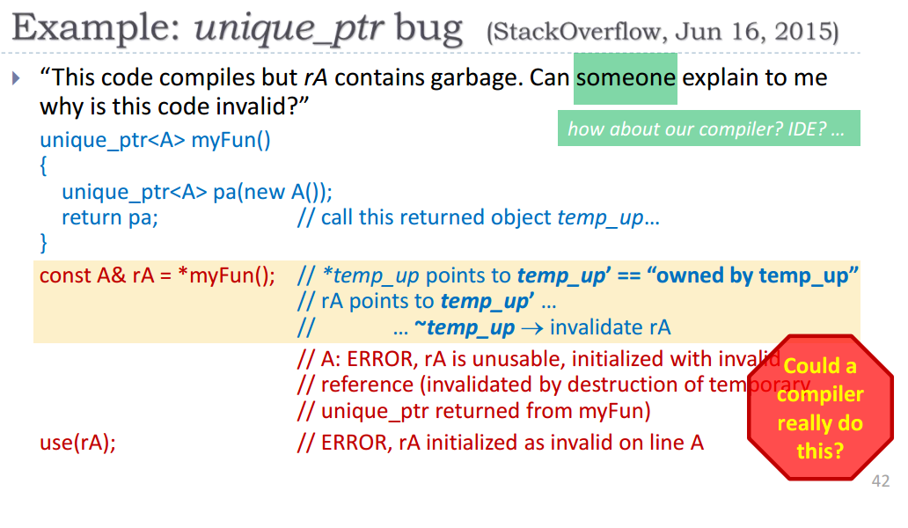
Writing Good C++14… by default

Slide 25
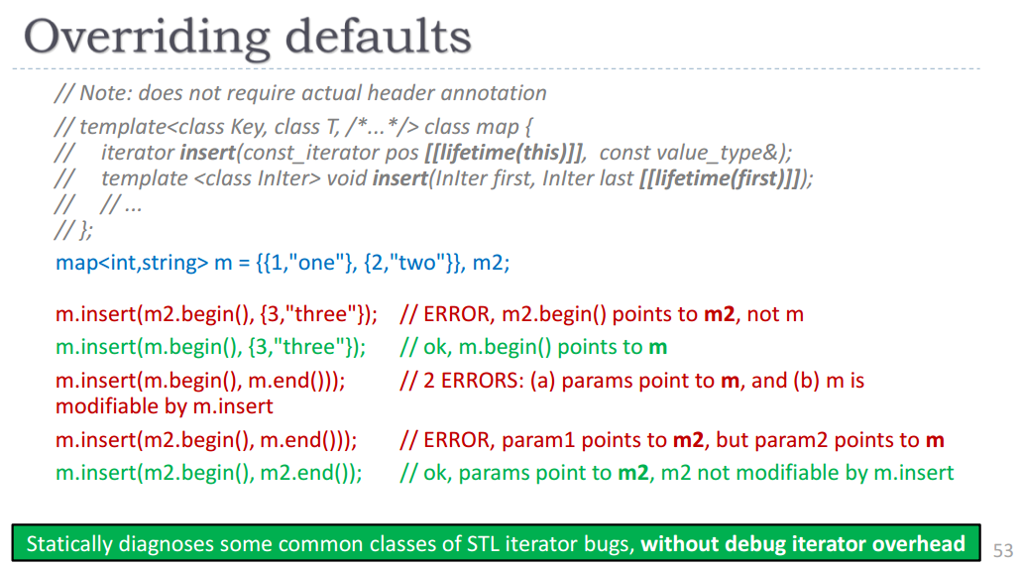
Writing Good C++14… by default

Slide 26
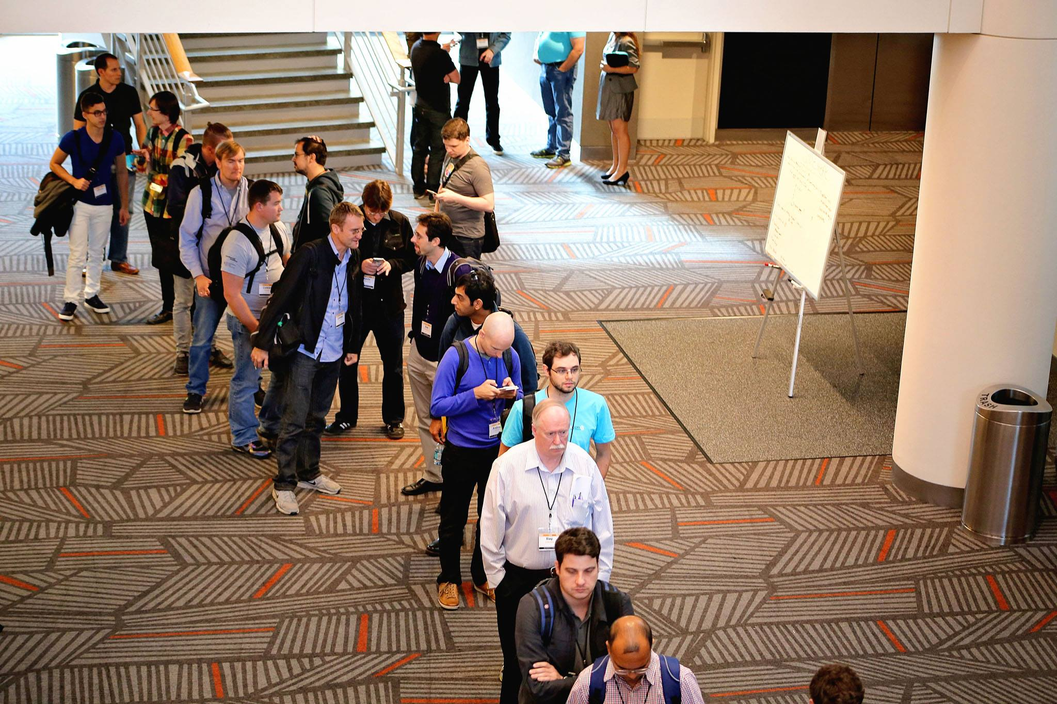
Break

Slide 27
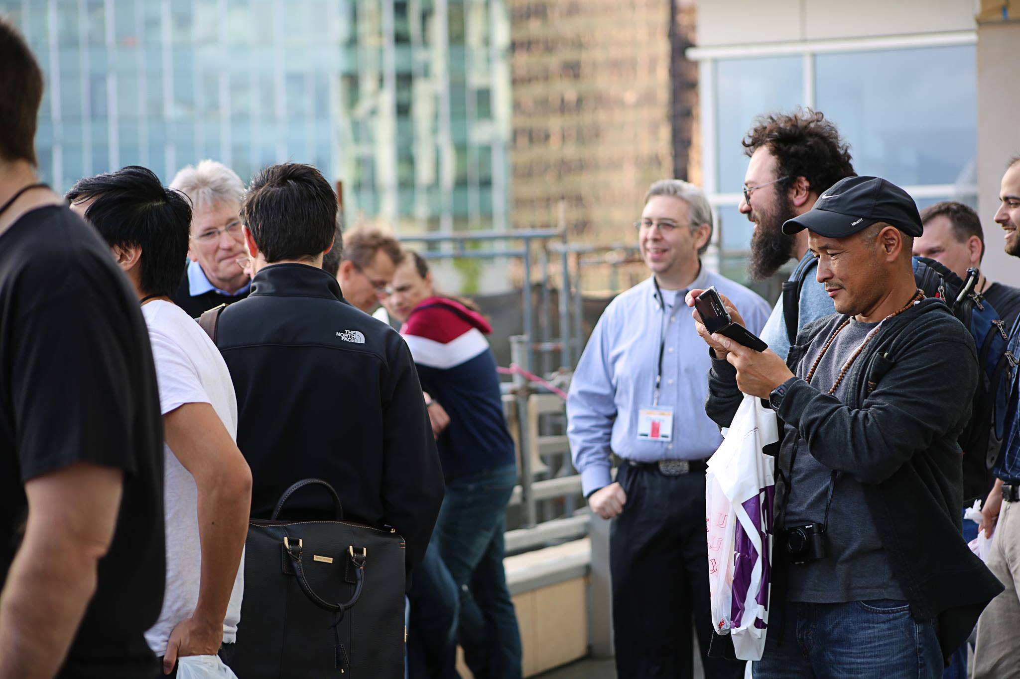
Break

Slide 28
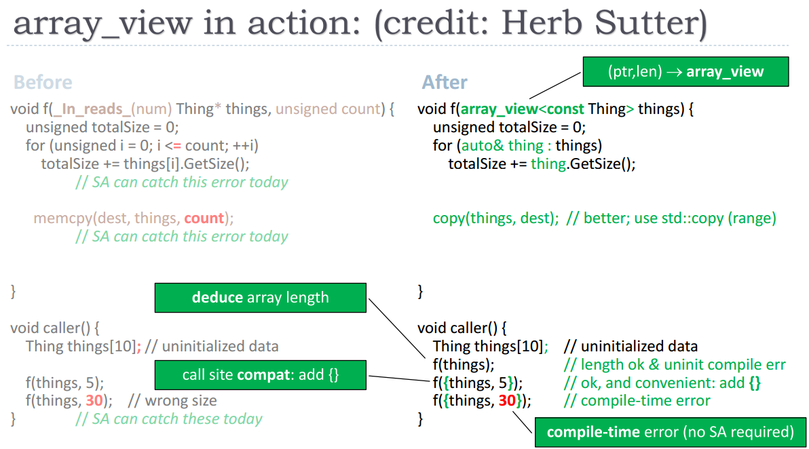
Evolving array_view for safer code

Slide 29
array_view< ValueType, Extents… >
A view over a contiguous range of elements with a known length
Pointer + length
Cheap to copy and move
Can replace any pointers that point to more than one object
Ensure that unsafe type conversions are prevented
Enforce bounds-safety, prevent dangling
Length can be fixed at compile time or specified at runtime
array_view<int> av1 = ...; // seq. of ints with dynamic length
array_view<int, dynamic_range> av2 = ...; // same as above
array_view<int, 10> av3 = ...; // sequence of exactly 10 ints

Slide 30
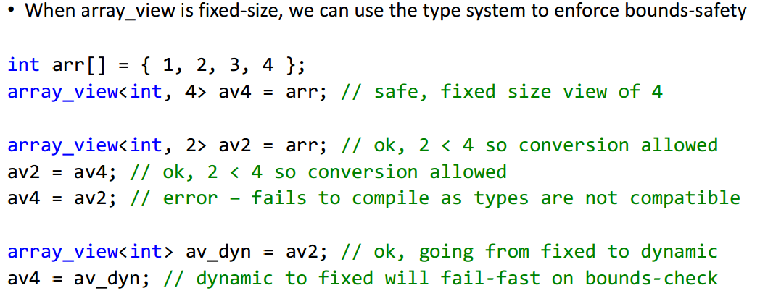
Safety Features

Slide 31
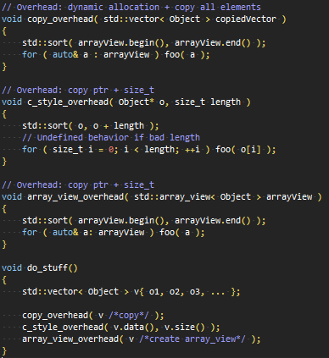
Array_view application

Slide 32

string_view< CharType, Extent >
Available in gcc (experimental)
A view of contiguous range of elements with a known length
Pointer + length
Cheap to copy and move
Just an alias for array_view

Slide 33
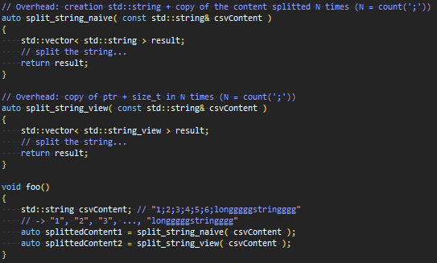
String_view application

Slide 34
Performance
Performance target: zero overhead
When compared to pointer + length code that has equivalent checks and ensures safety
Compared to unsafe code – some overhead, but as low as low as possible
Optimization can leverage guarantees provided by type system
Make it clear to the compiler you are a simple, safe type
Very likely to be shipped with C++17

Slide 35
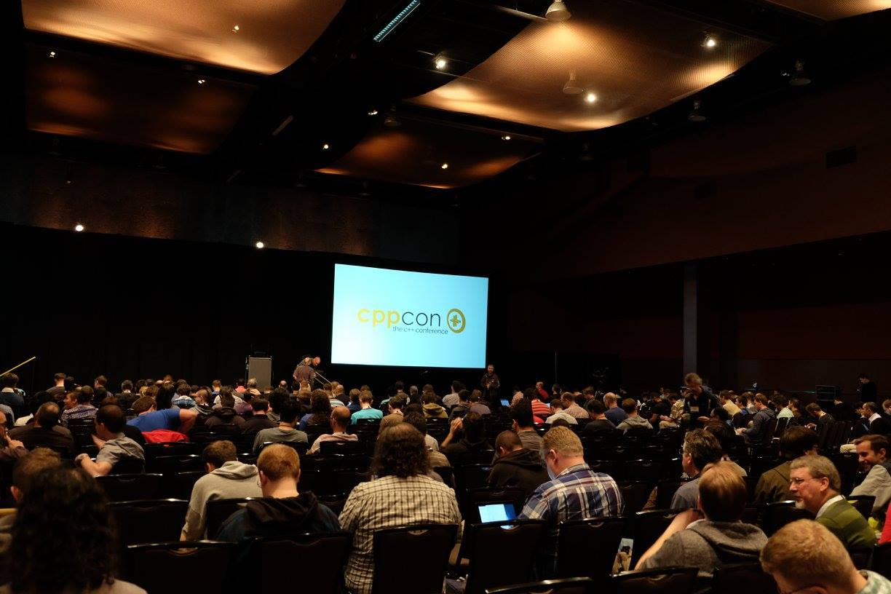
Break

Slide 36
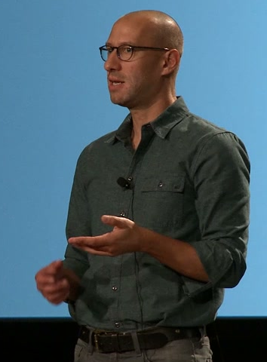
Ranges
Range Views
begin() / end() return iterator / sentinel
Lightweight, non-owning
Lazy sequence algorithms
On demand computation
Non lazy-computation possible
i.e. range to vector
Must be explicit (through ‘Action’)
Non-mutating
Composable

Slide 37
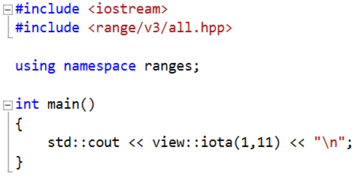
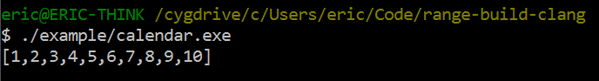
Ranges: iota
Does not return a std::vector but a view of range
Does compute on demand
i.e. for (auto i: view:iota(1, 11)) //until we reach a ‘sentinel’

Slide 38
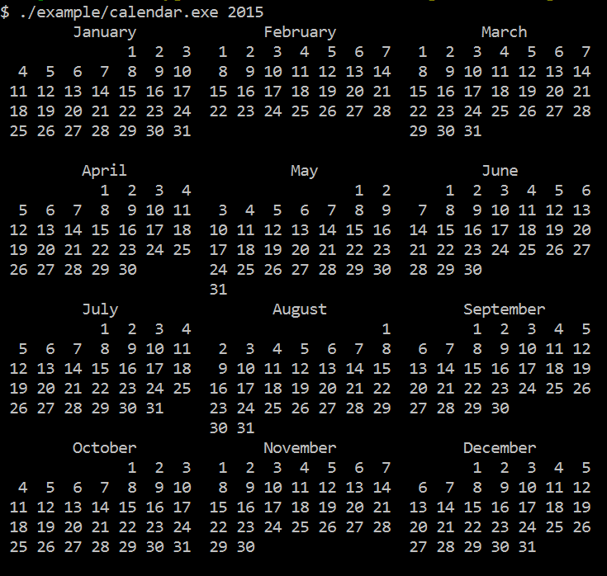
Goal of Eric Niebler KeyNote

Slide 39
#include <cstddef>
#include <string>
#include <vector>
#include <utility>
#include <iostream>
#include <stdexcept>
#include <functional>
#include <boost/format.hpp>
#include <boost/lexical_cast.hpp>
#include <boost/date_time/gregorian/gregorian.hpp>
#include <range/v3/all.hpp>
namespace greg = boost::gregorian;
using date = greg::date;
using day = greg::date_duration;
using namespace ranges;
using std::cout;
namespace boost { namespace gregorian {
date &operator++(date &d) { return d = d + day(1); }
date operator++(date &d, int) { return ++d - day(1); }
}}
namespace ranges {
template<> struct difference_type<date> {
using type = date::duration_type::duration_rep::int_type;
};
}
CONCEPT_ASSERT(Incrementable<date>());
auto dates_in_year(int year) {
return view::iota(date{year,greg::Jan,1},
date{year+1,greg::Jan,1});
}
auto by_month() {
return view::group_by([](date a, date b) {
return a.month() == b.month();
});
}
auto by_week() {
return view::group_by([](date a, date b) {
// ++a because week_numer is Mon-Sun and we want Sun-Sat
return (++a).week_number() == (++b).week_number();
});
}
std::string format_day(date d) {
return boost::str(boost::format("%|3|") % d.day());
}
// In: Range<Range<date>>: month grouped by weeks.
// Out: Range<std::string>: month with formatted weeks.
auto format_weeks() {
return view::transform([](/*Range<date>*/ auto week) {
return boost::str(boost::format("%1%%2%%|22t|")
% std::string((int)front(week).day_of_week() * 3, ' ')
% (week | view::transform(format_day) | action::join));
});
}
// Return a formatted string with the title of the month
// corresponding to a date.
std::string month_title(date d) {
return boost::str(boost::format("%|=22|")
% d.month().as_long_string());
}
// In: Range<Range<date>>: year of months of days
// Out: Range<Range<std::string>>: year of months of formatted wks
auto layout_months() {
return view::transform([](/*Range<date>*/ auto month) {
int week_count = distance(month | by_week());
return view::concat(
view::single(month_title(front(month))),
month | by_week() | format_weeks(),
view::repeat_n(std::string(22,' '),6-week_count));
});
}
// In: Range<T>
// Out: Range<Range<T>>, where each inner range has $n$ elements.
// The last range may have fewer.
template<class Rng>
class chunk_view : public range_adaptor<chunk_view<Rng>, Rng> {
CONCEPT_ASSERT(ForwardIterable<Rng>());
std::size_t n_;
friend range_access;
class adaptor;
adaptor begin_adaptor() {
return adaptor{n_, ranges::end(this->base())};
}
public:
chunk_view() = default;
chunk_view(Rng rng, std::size_t n)
: range_adaptor_t<chunk_view>(std::move(rng)), n_(n)
{}
};
template<class Rng>
class chunk_view<Rng>::adaptor : public adaptor_base {
std::size_t n_;
range_sentinel_t<Rng> end_;
using adaptor_base::prev;
public:
adaptor() = default;
adaptor(std::size_t n, range_sentinel_t<Rng> end)
: n_(n), end_(end)
{}
auto current(range_iterator_t<Rng> it) const {
return view::take(make_range(std::move(it), end_), n_);
}
void next(range_iterator_t<Rng> &it) {
ranges::advance(it, n_, end_);
}
};
// In: Range<T>
// Out: Range<Range<T>>, where each inner range has $n$ elements.
// The last range may have fewer.
auto chunk(std::size_t n) {
return make_pipeable([=](auto&& rng) {
using Rng = decltype(rng);
return chunk_view<view::all_t<Rng>>{
view::all(std::forward<Rng>(rng)), n};
});
}
// Flattens a range of ranges by iterating the inner
// ranges in round-robin fashion.
template<class Rngs>
class interleave_view : public range_facade<interleave_view<Rngs>> {
friend range_access;
std::vector<range_value_t<Rngs>> rngs_;
struct cursor;
cursor begin_cursor() {
return {0, &rngs_, view::transform(rngs_, ranges::begin)};
}
public:
interleave_view() = default;
explicit interleave_view(Rngs rngs)
: rngs_(std::move(rngs))
{}
};
template<class Rngs>
struct interleave_view<Rngs>::cursor {
std::size_t n_;
std::vector<range_value_t<Rngs>> *rngs_;
std::vector<range_iterator_t<range_value_t<Rngs>>> its_;
decltype(auto) current() const {
return *its_[n_];
}
void next() {
if(0 == ((++n_) %= its_.size()))
for_each(its_, [](auto& it){ ++it; });
}
bool done() const {
return n_ == 0 && its_.end() != mismatch(its_,
view::transform(*rngs_, ranges::end), std::not_equal_to<>()).first;
}
CONCEPT_REQUIRES(ForwardIterable<range_value_t<Rngs>>())
bool equal(cursor const& that) const {
return n_ == that.n_ && its_ == that.its_;
}
};
// In: Range<Range<T>>
// Out: Range<T>, flattened by walking the ranges
// round-robin fashion.
auto interleave() {
return make_pipeable([](auto&& rngs) {
using Rngs = decltype(rngs);
return interleave_view<view::all_t<Rngs>>(
view::all(std::forward<Rngs>(rngs)));
});
}
// In: Range<Range<T>>
// Out: Range<Range<T>>, transposing the rows and columns.
auto transpose() {
return make_pipeable([](auto&& rngs) {
using Rngs = decltype(rngs);
CONCEPT_ASSERT(ForwardIterable<Rngs>());
return std::forward<Rngs>(rngs)
| interleave()
| chunk(distance(rngs));
});
}
// In: Range<Range<Range<string>>>
// Out: Range<Range<Range<string>>>, transposing months.
auto transpose_months() {
return view::transform([](/*Range<Range<string>>*/ auto rng) {
return rng | transpose();
});
}
// In: Range<Range<string>>
// Out: Range<string>, joining the strings of the inner ranges
auto join_months() {
return view::transform([](/*Range<string>*/ auto rng) {
return action::join(rng);
});
}
int main(int argc, char *argv[]) try {
if(argc < 2) {
std::cerr << "Please enter the year to format.\n";
std::cerr << boost::format(" Usage: %1% <year>\n") % argv[0];
return 1;
}
int year = boost::lexical_cast<int>(argv[1]);
int months_per_line = 3;
auto calendar =
// Make a range of all the dates in a year:
dates_in_year(year)
// Group the dates by month:
| by_month()
// Format the month into a range of strings:
| layout_months()
// Group the months that belong side-by-side:
| chunk(months_per_line)
// Transpose the rows and columns of the size-by-side months:
| transpose_months()
// Ungroup the side-by-side months:
| view::join
// Join the strings of the transposed months:
| join_months();
// Write the result to stdout:
copy(calendar, ostream_iterator<>(std::cout, "\n"));
}
catch(std::exception &e) {
std::cerr << "ERROR: Unhandled exception\n";
std::cerr << " what(): " << e.what();
return 1;
}

Slide 40
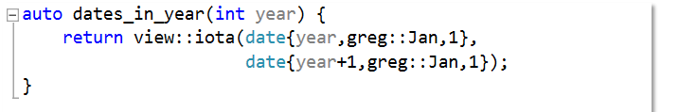
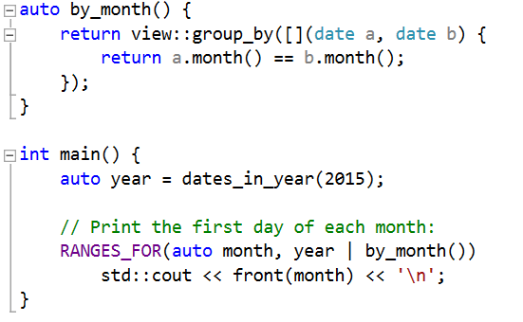
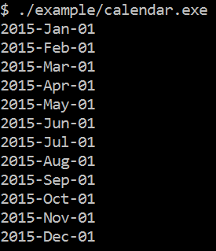
Ranges: Group Dates into Months

Slide 41
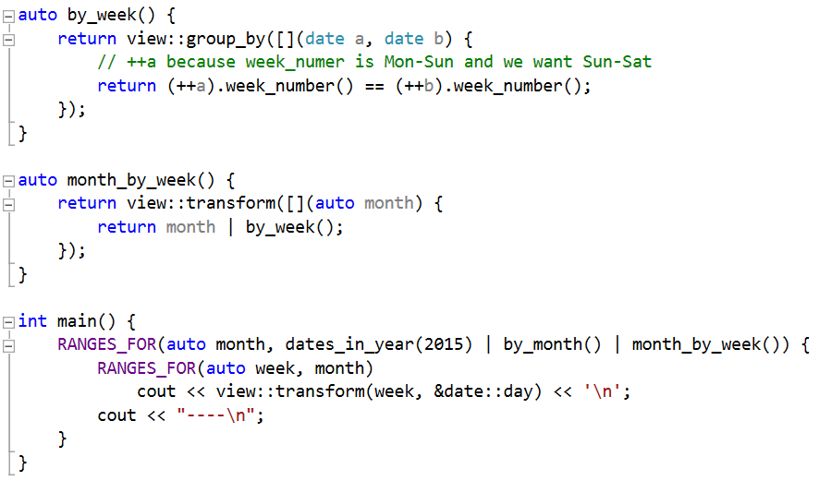
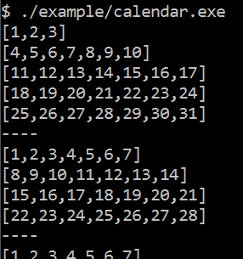
Ranges: Group Months into Weeks

Slide 42
Ranges
Partially coming with C++17 (as of March 2016)
Generalizing range-based for loops
Concepts likely postponed
STL v2 (containers/algos ranges aware) postponed
Full power likely for C++19 / C++20

Slide 43
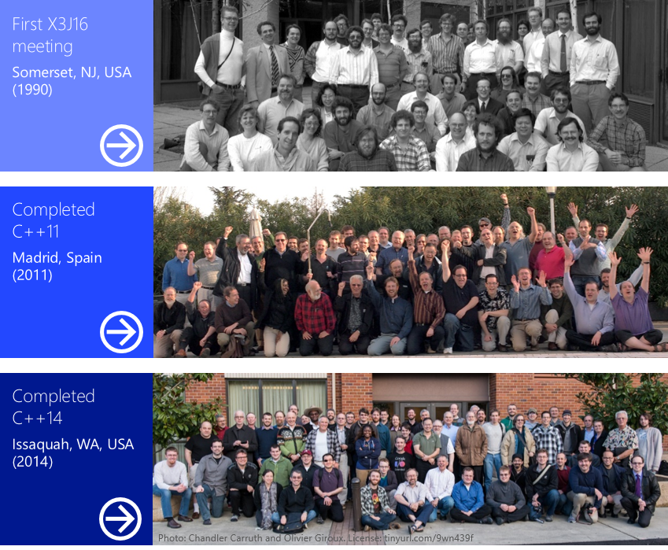
Working Group 21 (WG21): ISO C++ Committee

Slide 44
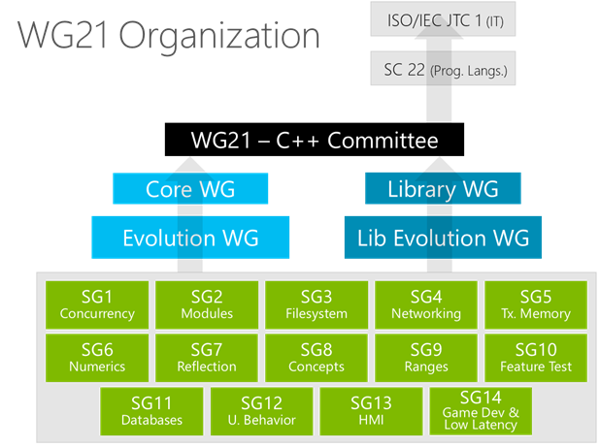
WG21: Subgroups And Study Groups
Organized into Sub-Groups
Core (responsible for new features)
Evolution
Library
Library Evolution
In Addition, Several Study Groups (SG)
Domain experts
Goal is to gather between expert to ease the creation of suitable and needed proposals
Chairman and some members are usually part of the main sub-groups

Slide 45
WG21: Basic Flow
Submit a Proposal (std-proposals forum)
Try to match your idea with a Study Group
Float the idea
Post an initial draft (TS: Technical Spec)
Got approved for upcoming meeting
Subgroup chairs give priority
EWG & LEWG responsible for new features that involve STL extensions
CWG & LWG do the evolution involved by proposals from EWG & LWG
During the meeting (2 to 3 times a year )
Reviewed by Sub-Groups
Voting
…
Rinse and repeat

Slide 46
WG21
Independent
Avoid sponsor influence for the priorisation
Freelance
Everyone can join and vote

Slide 47

Birth of the Study Group 14

Slide 48
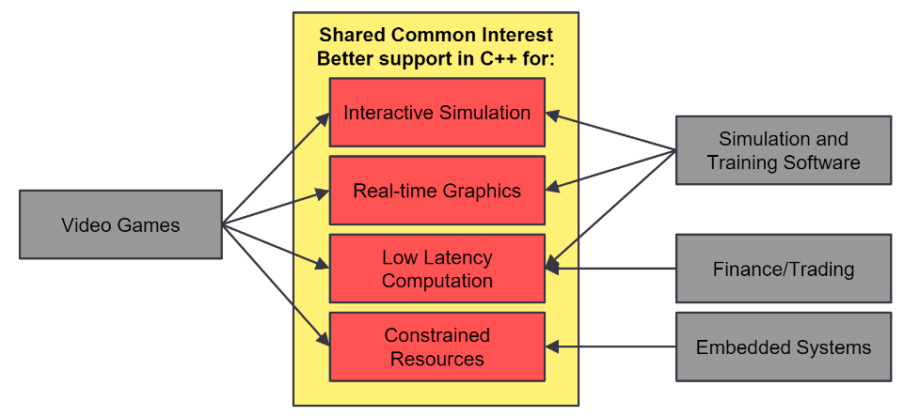
SG14: Goals and Scopes

Slide 49
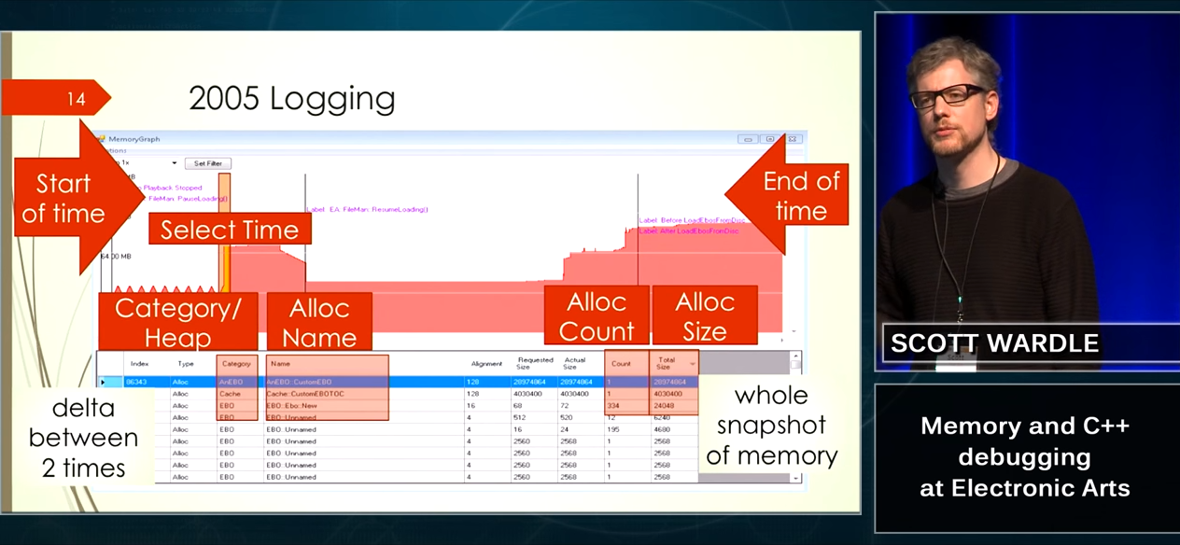
SG14: Focus
Memory Usage
Fixed memory budgets
Shared CPU/GPU
No swap space
Inconsistent Allocation Patterns
Small object optimizations
Vector growth rate and initial capacity
Does an empty container allocate
What size functor will require std::function to allocate
Behavior unpredictable and C++ implementation dependent

Slide 50
SG14: Focus
Costly Features
RTTI
Excessive data generated by e.g. dynamic_cast
Virtual functions
Poor inlining
Poor cache friendliness containers
No contiguous associative container
Exceptions
Restrict some optimizations for unwinding

Slide 51
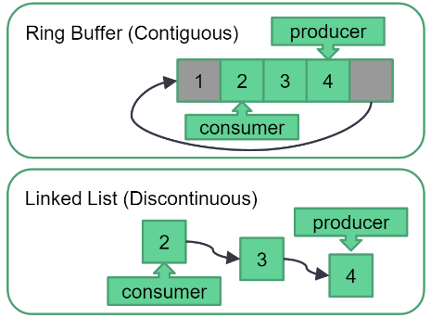
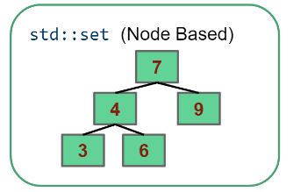
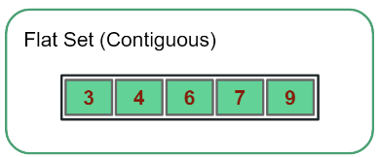
SG14: Current Effort
Fixed-points number
std::fixed_point<Repr, Exponent>
Ring Buffer
std::static_ring<T, N>
std::dynamic_ring<T, std::vector<N>>
Flat associative container
std::flat_set<T>

Slide 52
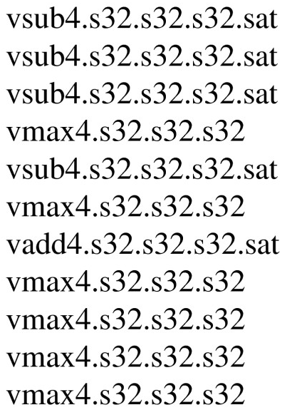
SG14: Related Work (with other SG)
Coroutines
Noexcept library additions
Use std::error_code for signaling errors
SIMD
SIMD polymorphism
SIMD vector
SIMD types
Language extension
for simd (;;) //…

Slide 53

Break

Slide 54
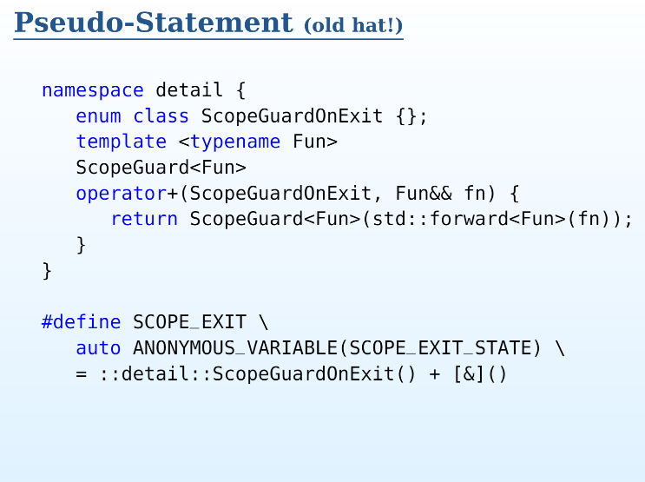
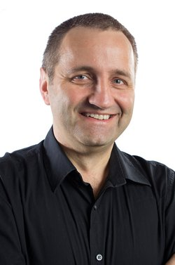
Declarative Control Flow

Slide 55
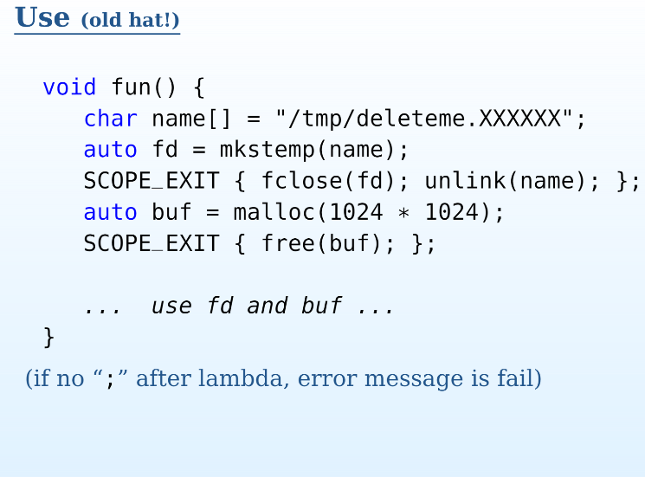
Declarative Control Flow

Slide 56
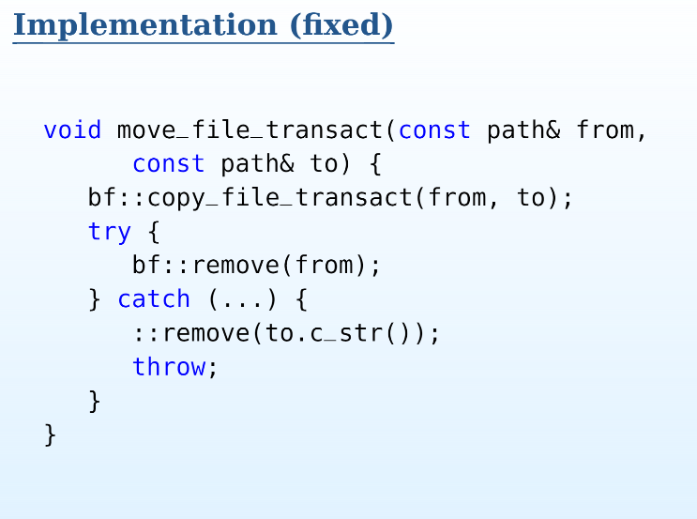
Declarative Control Flow

Slide 57
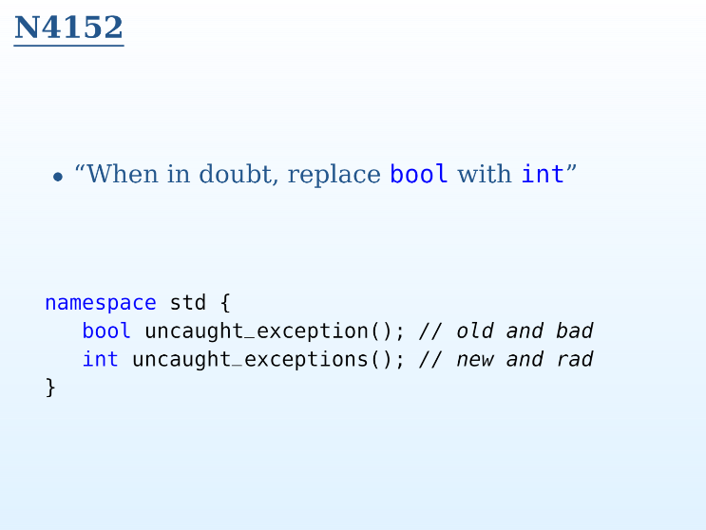
Declarative Control Flow

Slide 58

Declarative Control Flow

Slide 59

Break

Slide 60

Break

Slide 61

Break

Slide 62

Break

Slide 63



Coroutine
Enable explicit suspend and resume of it’s progress
Preserve execution state
Enhance control flow

Slide 64


Coroutine classification
User mode Thread / Fibers
Symmetric
Suspend – resume are glued together
when you suspend, you must resume another coroutine
More like a context switch
Stackful
Stack dependent
Save all the stack (at least 1Mb on Windows / 2Mb Linux)
Stackless Resumable Function
Asymmetric
Distinct suspend and resume operation
When calling resume on the coroutine, it get back where it was when it goes suspend
Stackless
Doesn’t own the stack
Save only the state of the coroutine

Slide 65

Coroutine: Synchronous call

Slide 66

Coroutine: Async call

Slide 67

Coroutine: Coroutine call

Slide 68

Coroutine: What about perf

Slide 69
Coroutine: Stackless resumable function
Highly scalable
To hundred millions of concurrent coroutines
Highly efficient
Resume / suspend comparable cost to function call overhead

Slide 70





Lock Free Programming: Another training?

Slide 71

Tuning C++: Benchmarking
Never rely on instinct
Always benchmark if you aim for performance
Use the same compilation flag as prod
Use profiling tools
Perf (or Vtune)
Analyze hotspot
Ensure code generated is intended (x86-64)
Vectorization
Code getting optimized away
Disable optimization on specific part of the benchmark
benchmark::DoNotOptimize
asm volatile("" : : "g"(p): "memory");
asm volatile("" : : : "memory");

Slide 72

C++17 and beyond (Updated March 2016)

Slide 73

C++17: Very-likely to come
Parallelism
Parallelized version of most STL algorithms
execution_policies
atomic<shared_ptr<T>>
Library Fundamentals
any, optional, string_view
void_t
Memory
memory_pools
polymorphic_allocator
Algorithm enhancement
search
Sample

Slide 74

C++17: Very-likely to come
File System TS
Files
Path
Symbolic Links
Recursive_directory_iterator
General enhancement
constexpr_if
Contiguous iterator
Tuple apply
Lambdas allowed within constexpr
Range-for loops can deal with sentinels
operator.
Default comparison operators

Slide 75

C++17 And beyond
Likely to come
Coroutines
Ranges (but not STL v2)
Networking
Unlikely
Modules
Concepts
What’s next
New working cycle
Either every 2 or 3 years (still undecided if C++19 or C++20 next)

Slide 76

The End

Slide 77
Top 5 recommended lectures
Pedro Ramalhete (Cisco) “How to make your data structures wait-free for reads"
Pablo Halpern (Intel) “Work Stealing"
Chandler Carruth (Google) "Tuning C++: Benchmarks, and CPUs, and Compilers! Oh My!"
Andrei Alexandrescu (ex Facebook) “std::allocator...”
Eric Niebler (Facebook) "Ranges for the Standard Library“

Slide 78
Questions?

